Slide 1

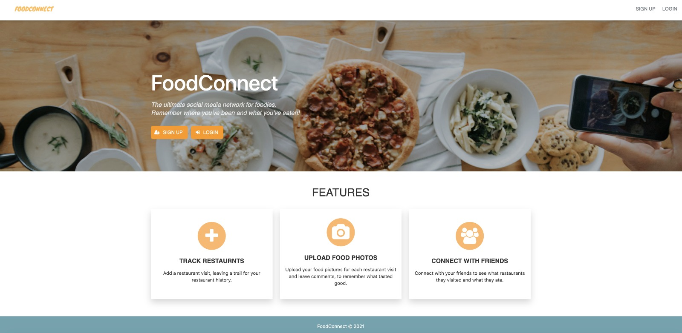
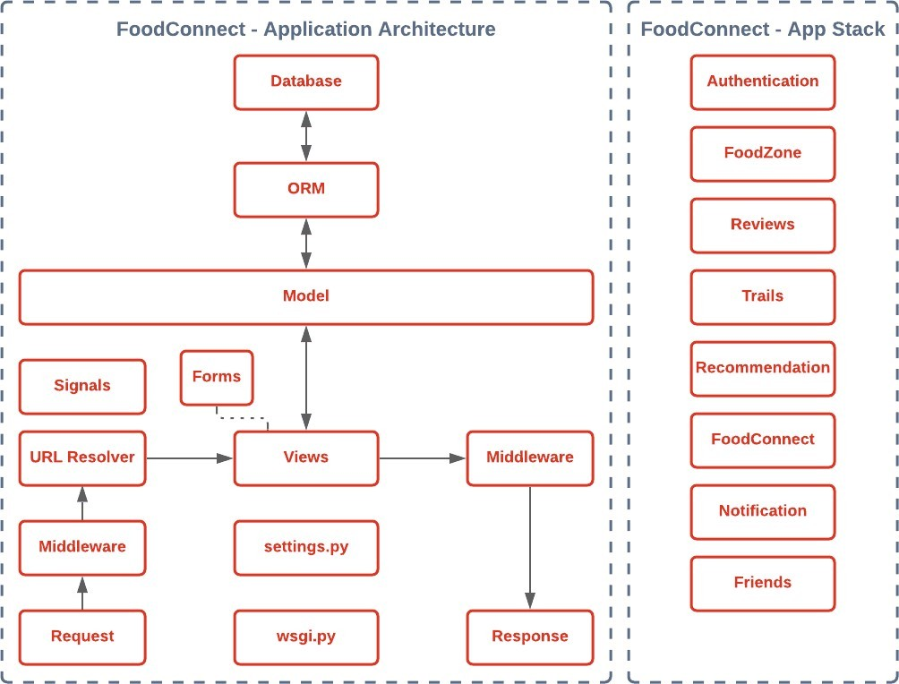
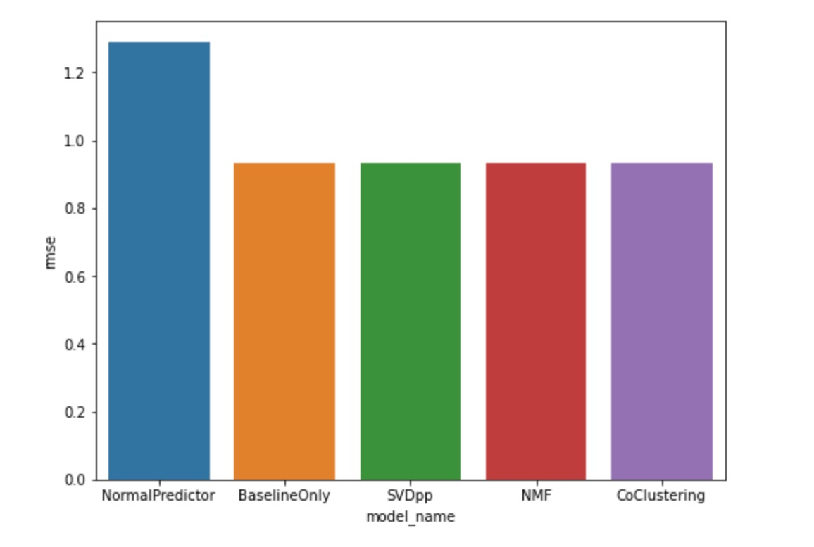
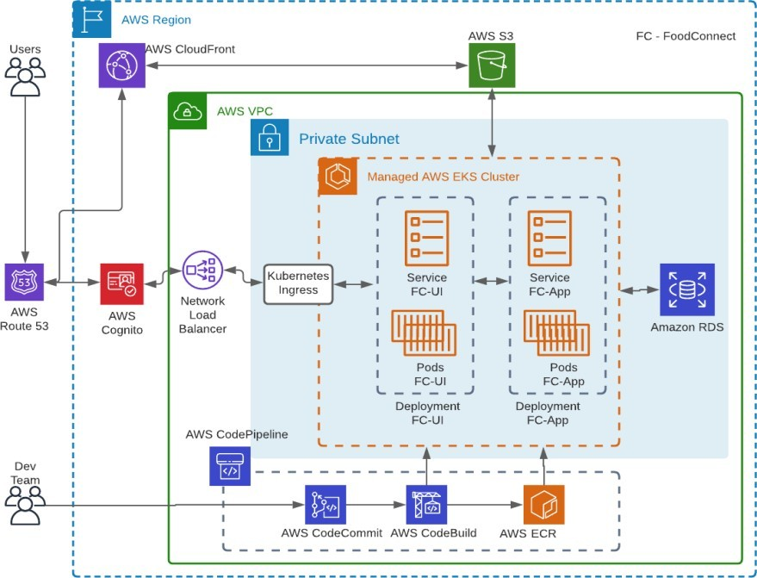
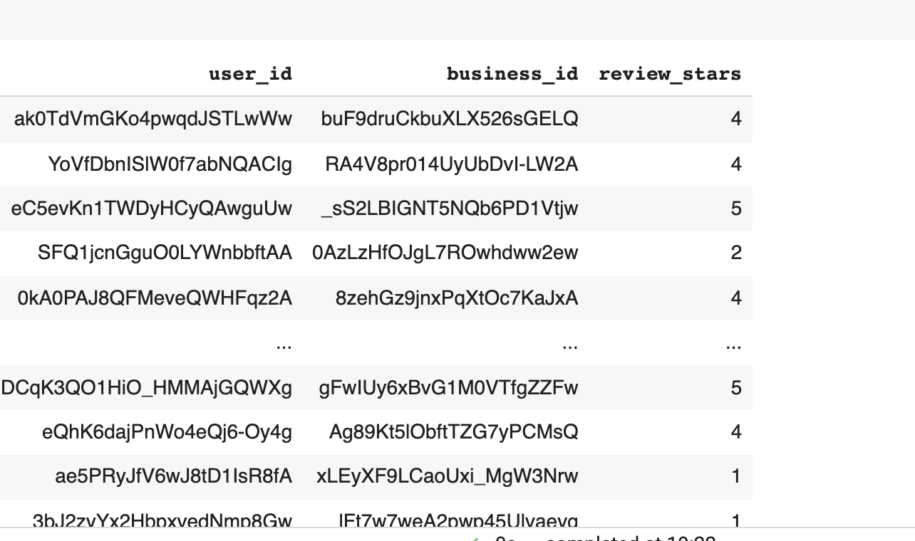
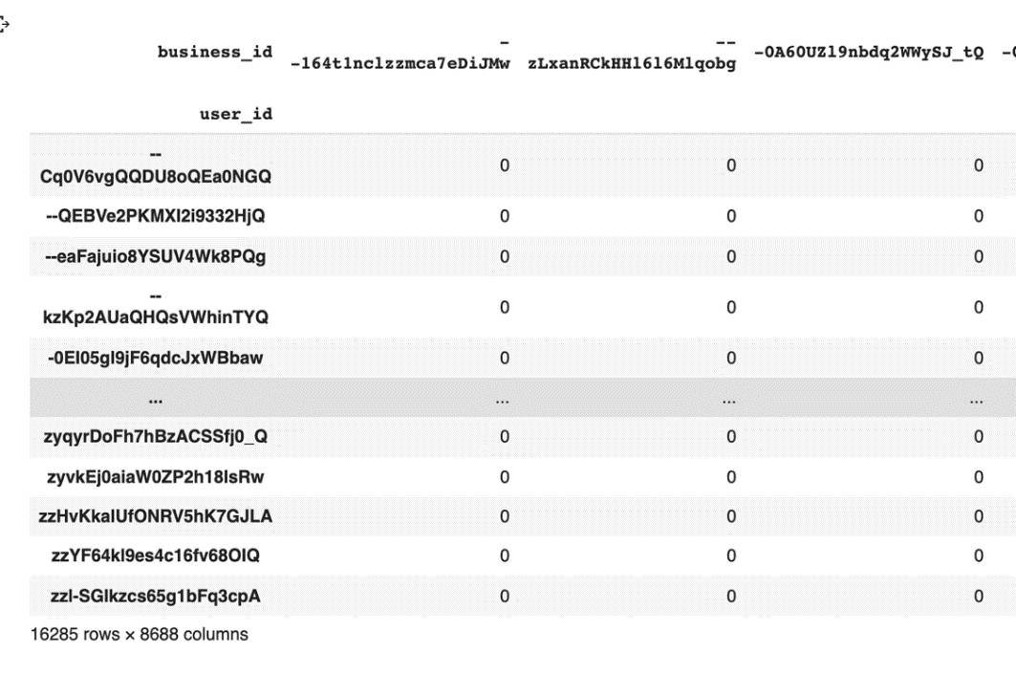
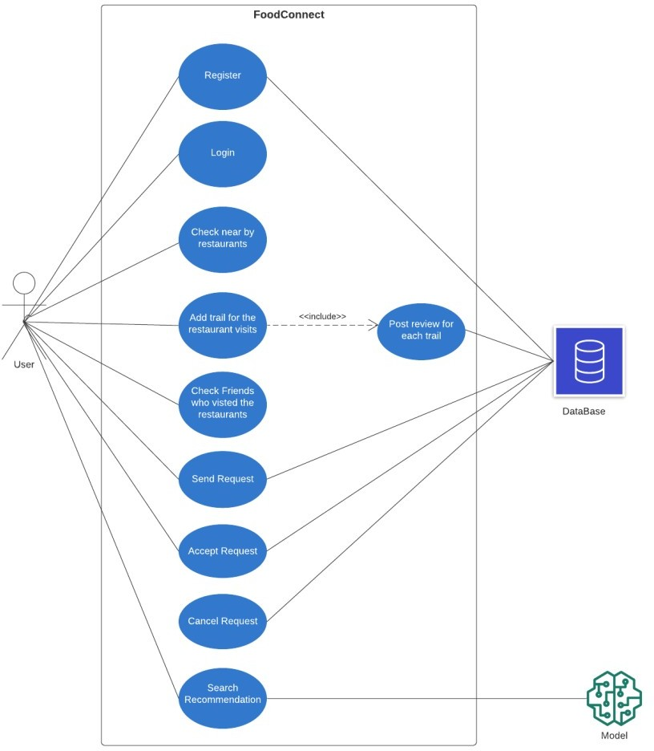
Computer Engineering Department
Food Connect
Project Advisor: Prof. Andrew Bond
Desai, Deesha (MS Software Engineering) Devendran, Priyanka (MS Computer Engineering)
Parihar, Preeti (MS Software Engineering)
Upadhya, Ananth (MS Software Engineering)
Benchmarks
Benchmarking were done both on the server side and front end side. A single node server was able to handle around 1200 concurrent requests. The memory consumption of the entire application is less than 65 MB. And the CPU utilization was lesser than 30 percent on a 4 core cpu. All the responses from the apis were coming in less than 200ms.
Introduction
Methodology
Restaurant Recommendation System
Food Connect is the platform where food lovers collectively share food experiences and can find new and exciting taste. For users to get personalized restaurant recommendations we have tried to build the recommendation engine for the restaurants. Using this Machine Learning Model, we will be recommending restaurants based on the restaurants that user has previously visited. We tried to provide recommendation based on collaborative filtering. We experimented User-Item based collaborative filtering and Item-Item Based collaborative filtering Methods.
Model Training and Evaluation
User-Item Collaborative Filtering: The Data was finally reduced to 17,00,000 reviews User-Item Collaborative Filtering. As the user that we have in our application is not going to be a part of the current dataset, we decided to take only the mean of the reviews of restaurants. Subsequently making the data reduction to 32000 restaurants ratings. Using this we have used Surprise Library which is used to build a recommendation engine. We Split the input data into 80% Train and 20% Testing datasets.
Item-Item Collaborative Filtering: In this type of recommendation system input is a restaurant (ITEM) and recommendation is a List of recommended restaurants(ITEM).
Food connect is a geosocial networking web application that enables users to check in the restaurants visited and share the restaurant details with friends. The application is used to discover and explore good restaurants nearby and provide valuable feedback about the restaurant visited. It is a platform that helps in connecting with people who love food and enables users to share their experiences on the restaurants visited, which would help users to identify good restaurants, recommended dishes, and services a restaurant has to offer. It enables the user to keep track of all the restaurants visited and provides a recommended list of good restaurants based on the user’s interest.
We are using AWS Elastic Kubernetes Service to deploy our microservices. It is a fully managed service. The AWS EKS cluster runs nodes which run services, pods for FoodConnect-UI and FoodConnect-App separately. AWS EKS is able to scale horizontally 6 seamlessly. It runs in a private subnet and is connected to a public network via Kubernetes Ingress via Network Load Balancer.
All incoming requests from AWS Route 53 are authenticated via AWS cognito and forwarded to the Network Load Balancer in the primary AWS Region. Whenever the Dev team pushes a new feature, it pushes via AWS DevOps pipeline which consists of AWS CodeCommit, AWS CodeBuild and AWS ECR. Once AWS ECR builds a new docker image and Kubernetes rolls out a new application in pods.
Application Architecture
FoodConnect has following Django application:
Authentication Module - Manages user authentication Reviews Module - Provides user rating, reviews and image upload related features.
Trails Module - Keeps track of user’s restaurant visits.
Recommendation Module - ML based restaurant, dish, friends recommendation.
FoodConnect Module - Main app which centrally manages other apps.
Notification Module -Send event notification such as friend requests, user restaurant visits etc.
Friends Module - Manages user’s friend network, such sending, accepting or rejecting requests.
Use Case Diagram
Summary/Conclusions
Food connect application would bring a lot of impact on people who would like to explore nearby restaurants, make friends, connect with them, and get to know about their friends food tastes and interests. The application is very unique as we can see the list of friends and their reviews on the restaurants visited by them. It helps in connecting with people who have similar food interests and also recommends restaurants which are nearby based on the reviews of the friends who have visited them. Users can see the reviews and ratings given by their friends on the restaurants visited and can make a record of all the restaurants visited.
[1] Sun, Zhida, Wang, Sitong, Yang, Wenjie, Yürüten, Onur, Shi, Chuhan, & Ma, Xiaojuan. (2020). Proceedings of the 2020 ACM Designing Interactive Systems Conference (DIS '20: Designing Interactive Systems Conference 2020). ACM.
[2] Khulbe, D. (2019). Modeling Food Popularity Dependencies using Social Media data [arXiv]. In arXiv (pp. 5–5).
[3] Tao, Kuan-Chuan, Lee, Yi-Ling, He, Bo-Jun, & Liu, Li-Wei. (2019). Proceedings of the 2019 3rd International Conference on E-Society, E-Education and ETechnology(ICSET 2019: 2019 The 3rd International Conference on E-Society, EEducation and E- Technology).ACM
Key References
People love eating food outside and would like to share their experiences with their friends. Food connect helps in addressing this requirement.
Methodology
Product Architecture
FoodConnect is a microservice based distributed system. To develop microservices we are using Django web application framework for backend, React for frontend and AWS based technology stack to build and deploy our microservices.
The application is used to discover and explore good restaurants nearby and provide valuable feedback about the restaurant visited. It is a platform that helps in connecting with people who love food and enables users to share their experiences on the restaurants visited, which would help users to identify good restaurants, recommended dishes, and services a restaurant has to offer. It enables the user to keep track of all the restaurants visited and provides a recommended list of good restaurants based on the user’s interests
Acknowledgements
Analysis and Results
Application Performance: Our application is a social networking website for food. Hence, it can be expected to have many users using our application at the same time. Hence, we will make sure that our system can handle multiple users I at the same time. And effectively handle requests from them. For this we will be using State of the art services from Amazon Web Services like CloudFront, Route 53, EKS etc. We will test this by doing Stress testing on our application by opening concurrent connections using Jmeter.

